Slide 1

Deep Learning
For
DeepFakes Creation & Detection
Amol Singh
Roll No. 231120003
M.Tech

Slide 2
OBJECTIVE
The objective of this project is to do 2 things namely-:
1)Survey of Algorithm used to create deepfakes.
2)Methods proposed to detect deepfakes in literature till date.
This study focuses on the critical issue of deepfakes, recognizing their significant challenge in today's landscape.
By examining state-of-the-art detection methods, the study offers a comprehensive understanding of deepfake techniques.
This knowledge serves as a foundation for developing new and more robust methods to address the growing complexity of deepfakes.

Slide 3
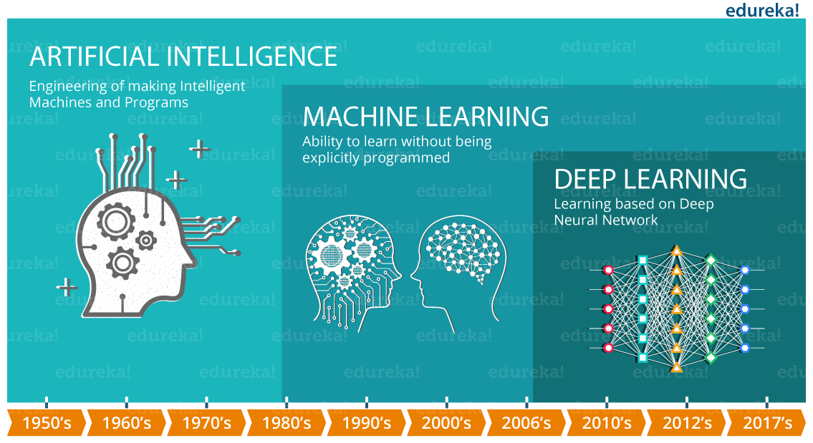
What is Deep Learning
Deep learning is a subset of machine learning that uses multi-layered neural networks, called deep neural networks, to simulate the complex decision-making power of the human brain.
Image Source: https://images.app.goo.gl/o4AK3832npShUiEL7
Reference: https://www.ibm.com/topics/deep-learning

Slide 4
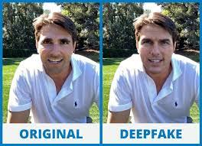
What are exactly deepfakes
Deepfakes, originating from "deep learning" and "fake," involve superimposing the face of a target person onto a video or image of a source person.
This creates a deceptive video or image where the target person appears to be doing or saying things performed by the source person.
Image Source: https://www.zee5.com/articles/all-you-need-to-know-about-deepfakes-and-why-they-are-dangerous
Reference: Thanh Thi Nguyen, Quoc Viet Hung Nguyen, Dung Tien Nguyen, Duc Thanh Nguyen, Thien Huynh-The, Saeid Nahavandi, Thanh Tam Nguyen, Quoc-Viet Pham, Cuong M. Nguyen, Deep learning for deepfakes creation and detection: A survey, Computer Vision and Image Understanding, Volume 223, 2022, 103525, ISSN 1077-3142.

Slide 5
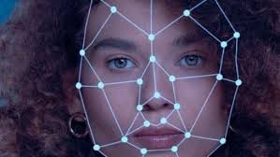
How deepfakes are created?
Deepfakes can be created in 2 ways-
1)Traditional visual effects or computer-graphics approaches.
2)By using deep learning models such as autoencoders and generative adversarial networks (GANs).
Image Source: -https://www.hindustantimes.com/technology/how-are-deepfake-videos-different-from-photoshopped-images-how-to-spot-them-101699350200035.html
Reference: Thanh Thi Nguyen, Quoc Viet Hung Nguyen, Dung Tien Nguyen, Duc Thanh Nguyen, Thien Huynh-The, Saeid Nahavandi, Thanh Tam Nguyen, Quoc-Viet Pham, Cuong M. Nguyen, Deep learning for deepfakes creation and detection: A survey, Computer Vision and Image Understanding, Volume 223, 2022, 103525, ISSN 1077-3142.

Slide 6
Pros and Cons of deepfakes
Cons of deepfakes include-
1)Deepfake methods pose a threat to global security by allowing the creation of videos featuring world leaders delivering false speeches for deceptive purposes.
2)Deepfake technology could be employed to produce fabricated satellite images of the Earth, depicting non-existent objects like fake bridges, which could potentially mislead military analysts and troops in battle scenarios
3)The recent release of DeepNude software highlights more disturbing threats, as it can transform individuals into non-consensual pornography.
4)The Chinese app Zao has gained viral popularity, allowing less-skilled users to swap their faces onto those of movie stars and insert themselves into famous movie and TV scenes.
Reference: Thanh Thi Nguyen, Quoc Viet Hung Nguyen, Dung Tien Nguyen, Duc Thanh Nguyen, Thien Huynh-The, Saeid Nahavandi, Thanh Tam Nguyen, Quoc-Viet Pham, Cuong M. Nguyen, Deep learning for deepfakes creation and detection: A survey, Computer Vision and Image Understanding, Volume 223, 2022, 103525, ISSN 1077-3142.

Slide 7
Pros and Cons of deepfakes
Pros of deepfakes include-
1) Deepfake technology, despite its controversies, offers numerous beneficial applications. It enhances visual effects, creates digital avatars, develops Snapchat filters, restores lost voices, and updates movie episodes seamlessly.
2)Deepfakes can positively impact various fields like photography, video games, virtual reality, movie productions, and entertainment. Examples include realistic video dubbing for foreign films, educational reanimation of historical figures, virtual clothes try-on in shopping, and more.
Reference: Thanh Thi Nguyen, Quoc Viet Hung Nguyen, Dung Tien Nguyen, Duc Thanh Nguyen, Thien Huynh-The, Saeid Nahavandi, Thanh Tam Nguyen, Quoc-Viet Pham, Cuong M. Nguyen, Deep learning for deepfakes creation and detection: A survey, Computer Vision and Image Understanding, Volume 223, 2022, 103525, ISSN 1077-3142.

Slide 8
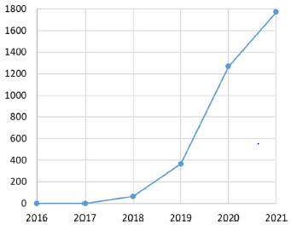
Initiatives taken to prevent these deepfakes
DARPA's Media Forensics (MediFor), USA program aims to expedite the development of detection methods for fake digital visual media.
Facebook, along with Microsoft and the Partnership on AI coalition, initiated the Deepfake Detection Challenge to stimulate research and development aimed at detecting and preventing its deceptive use.
Data from https://app.dimensions.ai at the end of 2021 reveals a significant increase in the number of deepfake papers in recent years, indicating a rising research trend in this area.
Reference: Thanh Thi Nguyen, Quoc Viet Hung Nguyen, Dung Tien Nguyen, Duc Thanh Nguyen, Thien Huynh-The, Saeid Nahavandi, Thanh Tam Nguyen, Quoc-Viet Pham, Cuong M. Nguyen, Deep learning for deepfakes creation and detection: A survey, Computer Vision and Image Understanding, Volume 223, 2022, 103525, ISSN 1077-3142.

Slide 9
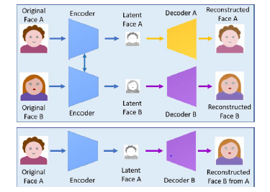
How deepfakes are created?
A) Autoencoder–Decoder pairing structure
1)Autoencoders are employed to extract latent features from face images, with the decoder reconstructing the images.
2)To swap faces between source and target images, two encoder-decoder pairs are utilized, with the encoder parameters shared between them.
3)This enables the common encoder to identify similarities between the two sets of face images, facilitating the swapping process.
4)Fig. shows a deepfake creation process where the feature set of face A is connected with the decoder B to reconstruct face B from the original face A.
Reference: Thanh Thi Nguyen, Quoc Viet Hung Nguyen, Dung Tien Nguyen, Duc Thanh Nguyen, Thien Huynh-The, Saeid Nahavandi, Thanh Tam Nguyen, Quoc-Viet Pham, Cuong M. Nguyen, Deep learning for deepfakes creation and detection: A survey, Computer Vision and Image Understanding, Volume 223, 2022, 103525, ISSN 1077-3142.

Slide 10
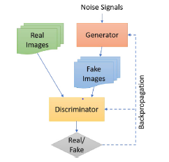
How deepfakes are created?
B) Conventional GAN model
1)In a conventional GAN model, there are two neural networks: a generator (G) and a discriminator (D).
2)The generator aims to produce images similar to real ones from noise signals, while the discriminator's goal is to classify images as real or fake.
3)They engage in a minimax game where G tries to minimize the probability of its outputs being classified as fake by D.
4)This represents the game, where G and D improve their capabilities through training.Fig tries to depict the same.
Reference: Thanh Thi Nguyen, Quoc Viet Hung Nguyen, Dung Tien Nguyen, Duc Thanh Nguyen, Thien Huynh-The, Saeid Nahavandi, Thanh Tam Nguyen, Quoc-Viet Pham, Cuong M. Nguyen, Deep learning for deepfakes creation and detection: A survey, Computer Vision and Image Understanding, Volume 223, 2022, 103525, ISSN 1077-3142.

Slide 11
How deepfakes are detected?
Deepfake detection is typically approached as a binary classification problem distinguishing between authentic and tampered videos.
However, the effectiveness of existing methods is limited, as demonstrated by recent research.
Korshunov and Marcel (2019) addressed this challenge by creating a deepfake dataset comprising 620 videos generated using Faceswap-GAN, based on the VidTIMIT database.
Despite efforts, popular face recognition systems like VGG and Facenet struggle to detect deepfakes accurately. Additionally, lip-syncing methods and image quality metrics with SVM exhibit high error rates on this dataset.
Reference: Thanh Thi Nguyen, Quoc Viet Hung Nguyen, Dung Tien Nguyen, Duc Thanh Nguyen, Thien Huynh-The, Saeid Nahavandi, Thanh Tam Nguyen, Quoc-Viet Pham, Cuong M. Nguyen, Deep learning for deepfakes creation and detection: A survey, Computer Vision and Image Understanding, Volume 223, 2022, 103525, ISSN 1077-3142.

Slide 12
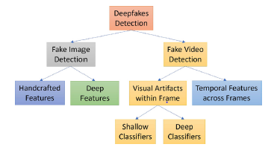
Fake Image and Video Detection
Fake image detection is divided into 2 parts-
1)Handcrafted features based methods
2)Deep features based methods
Fake video detection is also divided into 2 parts-
1)Temporal features across frames
2)Visual artifacts within a video frame.
Reference: Thanh Thi Nguyen, Quoc Viet Hung Nguyen, Dung Tien Nguyen, Duc Thanh Nguyen, Thien Huynh-The, Saeid Nahavandi, Thanh Tam Nguyen, Quoc-Viet Pham, Cuong M. Nguyen, Deep learning for deepfakes creation and detection: A survey, Computer Vision and Image Understanding, Volume 223, 2022, 103525, ISSN 1077-3142.

Slide 13
Fake Image Detection
Handcrafted features-based methods
Hand Crafted" features refer to properties derived using various algorithms using the information present in the image itself. Some of the methods are-
Xuan et al. (2019) introduced an image preprocessing step to remove specific clues from GAN-generated images, improving the generalization of forensic classifiers.
Zhang et al. (2017) employed the bag-of-words method for feature extraction and classification to discriminate between manipulated and genuine images.
Agarwal and Varshney (2019) framed GAN-based deepfake detection as a hypothesis testing problem, using a statistical framework based on information theory to measure the distance between distributions of legitimate and GAN-generated images.
Reference: Thanh Thi Nguyen, Quoc Viet Hung Nguyen, Dung Tien Nguyen, Duc Thanh Nguyen, Thien Huynh-The, Saeid Nahavandi, Thanh Tam Nguyen, Quoc-Viet Pham, Cuong M. Nguyen, Deep learning for deepfakes creation and detection: A survey, Computer Vision and Image Understanding, Volume 223, 2022, 103525, ISSN 1077-3142.

Slide 14
Fake Image Detection
Deep features-based methods
Deep features based methods are the methods to combat the proliferation of manipulated images and videos in the realm of deep learning techniques.
Hsu et al. (2020) introduced a two-phase deep learning approach utilizing a Siamese network architecture for feature extraction and a neural network classifier for final detection, demonstrating superior performance across various GAN variants and datasets.
Guo et al. (2021) developed SCnet, a CNN model designed specifically for detecting deepfake images generated by the Glow-based facial forgery tool, outperforming existing models like Meso-4 in terms of accuracy and generalization.
Zhao et al. (2021) focused on detecting deepfakes by analyzing the self-consistency of local source features in images, leveraging CNN models and pairwise self-consistency learning to capture spatially-local information.
Reference: Thanh Thi Nguyen, Quoc Viet Hung Nguyen, Dung Tien Nguyen, Duc Thanh Nguyen, Thien Huynh-The, Saeid Nahavandi, Thanh Tam Nguyen, Quoc-Viet Pham, Cuong M. Nguyen, Deep learning for deepfakes creation and detection: A survey, Computer Vision and Image Understanding, Volume 223, 2022, 103525, ISSN 1077-3142.

Slide 15
Fake Video Detection
Temporal Feature-Based Methods
Temporal features are derived from the signals in the time domain. Temporal = Time Example, Video consists of image frame sequence. With respect to time the frames are changed in video. This is called Temporal Information.
Güera and Delp (2018) introduced a temporal-aware pipeline method using CNN and LSTM to detect deepfake videos based on intra-frame and temporal inconsistencies, achieving over 97% accuracy on a dataset of 600 videos.
Li et al. (2018) proposed using eye blinking as a physiological signal to detect deepfakes, exploiting the lower blinking rates in deepfake videos compared to authentic ones.
Caldelli et al. (2021) utilized optical flow fields to capture motion patterns and inconsistencies between synthetically created and authentic frames, achieving comparable performance with state-of-the-art methods on the FaceForensics++ dataset.
These approaches demonstrate the effectiveness of leveraging temporal features and inconsistencies for deepfake detection.
Reference: Thanh Thi Nguyen, Quoc Viet Hung Nguyen, Dung Tien Nguyen, Duc Thanh Nguyen, Thien Huynh-The, Saeid Nahavandi, Thanh Tam Nguyen, Quoc-Viet Pham, Cuong M. Nguyen, Deep learning for deepfakes creation and detection: A survey, Computer Vision and Image Understanding, Volume 223, 2022, 103525, ISSN 1077-3142.

Slide 16
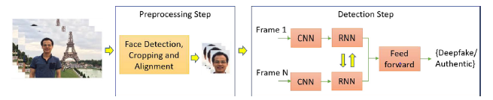
Fake Video Detection
A recurrent convolutional model (RCN) was developed by integrating DenseNet, a convolutional network introduced by Huang et al. (2017), and gated recurrent unit cells, proposed by Cho et al. (2014).
This model aims to exploit temporal discrepancies across frames for deepfake detection.(Fig).
Reference: Thanh Thi Nguyen, Quoc Viet Hung Nguyen, Dung Tien Nguyen, Duc Thanh Nguyen, Thien Huynh-The, Saeid Nahavandi, Thanh Tam Nguyen, Quoc-Viet Pham, Cuong M. Nguyen, Deep learning for deepfakes creation and detection: A survey, Computer Vision and Image Understanding, Volume 223, 2022, 103525, ISSN 1077-3142.

Slide 17
Fake Video Detection
Visual artifacts within video frame
The term “artifact” is used to broadly describe defects or foreign, unwanted elements in a video. There can be any number of causes ranging from lossy compression, improper conversions, to post-processing adjustments like sharpening and resampling. These are further classified into-
Deep Classifier Methods: In deep classifiers methods accuracy is used as the performance parameter.
Artifact-Based Detection with CNNs (Li and Lyu, 2018): This method identifies deepfake videos by analyzing artifacts introduced during the face warping step of generation algorithms, utilizing CNN models like VGG16 and ResNet variants.
Capsule Networks (Nguyen et al., 2019): Capsule networks capture hierarchical pose relationships to detect manipulated images and videos, showing superior performance across various datasets compared to existing methods.
Reference: Thanh Thi Nguyen, Quoc Viet Hung Nguyen, Dung Tien Nguyen, Duc Thanh Nguyen, Thien Huynh-The, Saeid Nahavandi, Thanh Tam Nguyen, Quoc-Viet Pham, Cuong M. Nguyen, Deep learning for deepfakes creation and detection: A survey, Computer Vision and Image Understanding, Volume 223, 2022, 103525, ISSN 1077-3142.

Slide 18
Fake Video Detection
Shallow Classifier Methods: In shallow classifiers the results are discussed using accuracy, precision, and recall as performance parameters.
3D Head Pose-Based Detection (Yang et al., 2019): This method uses differences in 3D head poses estimated from facial landmarks, employing SVM classifiers for detection. Evaluation on datasets like UADFV demonstrates efficacy against competing approaches.
Visual Feature-Based Detection (Matern et al., 2019): Exploiting visual artifacts and texture features, this approach distinguishes real and fake videos using logistic regression and small neural networks, showing promising results on YouTube videos.
PRNU Analysis (Koopman et al., 2018): This method utilizes PRNU analysis to detect deepfakes by examining alterations in local PRNU patterns, demonstrating potential in detection despite requiring further testing on larger datasets.
Reference: Thanh Thi Nguyen, Quoc Viet Hung Nguyen, Dung Tien Nguyen, Duc Thanh Nguyen, Thien Huynh-The, Saeid Nahavandi, Thanh Tam Nguyen, Quoc-Viet Pham, Cuong M. Nguyen, Deep learning for deepfakes creation and detection: A survey, Computer Vision and Image Understanding, Volume 223, 2022, 103525, ISSN 1077-3142.

Slide 19
Possible methods to detect deepfakes…
Detecting deepfakes poses a significant challenge due to the rapid advancements in generative models and the increasing sophistication of manipulation techniques.
However, several promising approaches can be explored to enhance deepfake detection:-
1)Visual Artifacts Analysis
2)Audio-Visual Affective Cues
3)Explainable Deepfake Detection
4)Interdisciplinary Collaboration
5)Dataset Expansion and Benchmarking
6)Adversarial Training
7)Awareness and Education Initiatives

Slide 20
Discussion and future research directions
The proliferation of deepfakes, driven by advances in deep learning and social media dissemination, poses significant security threats.
To combat this, the research community focuses on developing deepfake detection algorithms, amidst a growing battle between creators and detectors.
Improving detection accuracy involves creating updated benchmark datasets and enhancing performance in cross-forgery scenarios.
Adversarial attacks add complexity, necessitating robust methods.
Integrating detection into social media platforms and legal actions against tech companies can help mitigate impacts.
Understanding the social context of deepfakes is crucial, and in legal settings, documenting digital media forensics is essential.
While AI algorithms are accurate, their lack of explainability is a challenge, emphasizing the need for explainable AI in forensic applications.
Addressing these challenges requires ongoing interdisciplinary research and collaboration.
Reference: Thanh Thi Nguyen, Quoc Viet Hung Nguyen, Dung Tien Nguyen, Duc Thanh Nguyen, Thien Huynh-The, Saeid Nahavandi, Thanh Tam Nguyen, Quoc-Viet Pham, Cuong M. Nguyen, Deep learning for deepfakes creation and detection: A survey, Computer Vision and Image Understanding, Volume 223, 2022, 103525, ISSN 1077-3142.

Slide 21
CONCLUSIONS
Deepfakes have become a significant threat, undermining trust in media content and posing various negative consequences such as distress to targets, exacerbation of disinformation and hate speech, and even incitement of political tensions or violence.
With increasingly accessible technologies for creating deepfakes and the rapid dissemination of fake content through social media platforms, the need for effective detection methods is urgent.
This survey offers a comprehensive overview of both deepfake creation and detection techniques, along with a discussion of the challenges, potential trends, and future directions in this field.
It serves as a valuable resource for the artificial intelligence research community, guiding the development of robust methods to combat the spread of deepfakes and mitigate their harmful effects on society.

